Slide 1
Thevenin and Norton “Equivalent” Circuits
Voltage Source Model
Current Source Model
ECE 201 Circuit Theory I

Slide 2
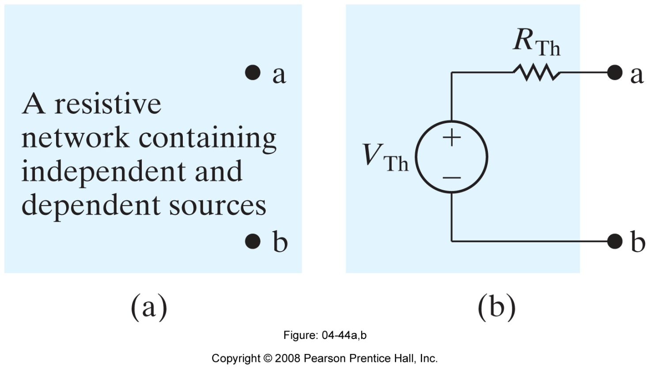
Why do we need them?
Circuit “simplification”
Reduce the complicated circuit on the left to a voltage source in series with a resistor.
ECE 201 Circuit Theory I

Slide 3
Conditions for the Thevenin Equivalent
The Thevenin circuit must be “equivalent” from the terminal point of view, that is, it must provide the same voltage and current to the “load” as the original circuit.
This “equivalence” must hold for all values of load resistance.
ECE 201 Circuit Theory I

Slide 4
Open-Circuit Consideration
When the load resistance on the original circuit tends towards infinity, the current goes to zero, but there is still an “open-circuit” voltage at the load terminals.
This “open-circuit” voltage must be provided by the Thevenin equivalent circuit.
ECE 201 Circuit Theory I

Slide 5

Open-Circuit Conditions
There is an open-circuit voltage at the a-b terminals in the original circuit.
The open-circuit voltage is provided by the voltage source in the Thevenin equivalent circuit.
ECE 201 Circuit Theory I

Slide 6
Short-Circuit Considerations
When the load resistance on the original circuit tends towards a short circuit, the circuit provides a “short-circuit” current to the load.
This “short-circuit” current must also be provided by the Thevenin equivalent circuit.
ECE 201 Circuit Theory I

Slide 7
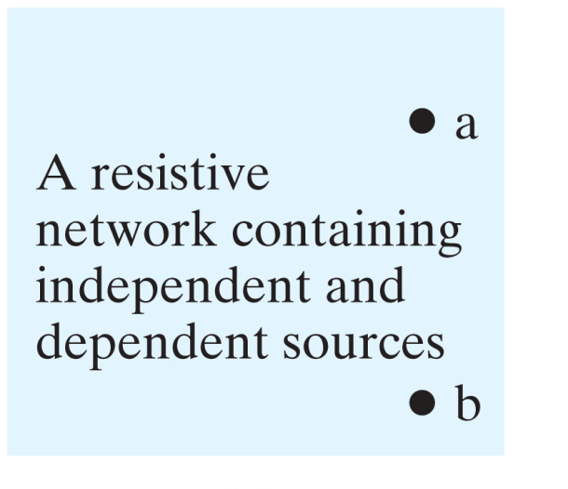
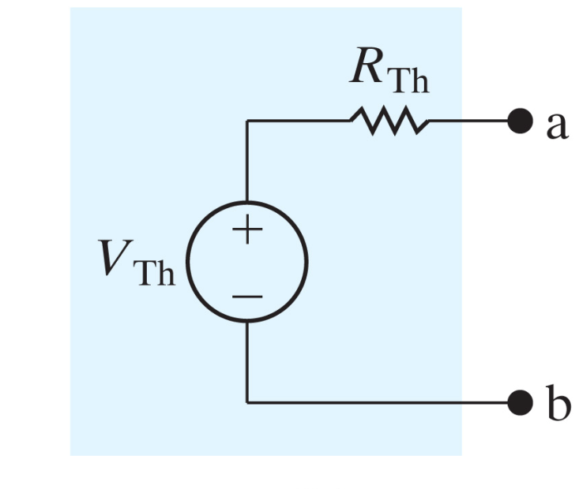

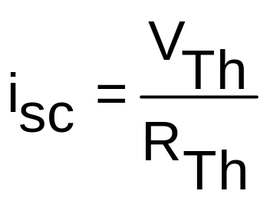
Short-Circuit Conditions
The short-circuit current that flows in the Thevenin equivalent must be identical to the current that flows in the original circuit.
i_{sc}
i_{sc}
ECE 201 Circuit Theory I

Slide 8
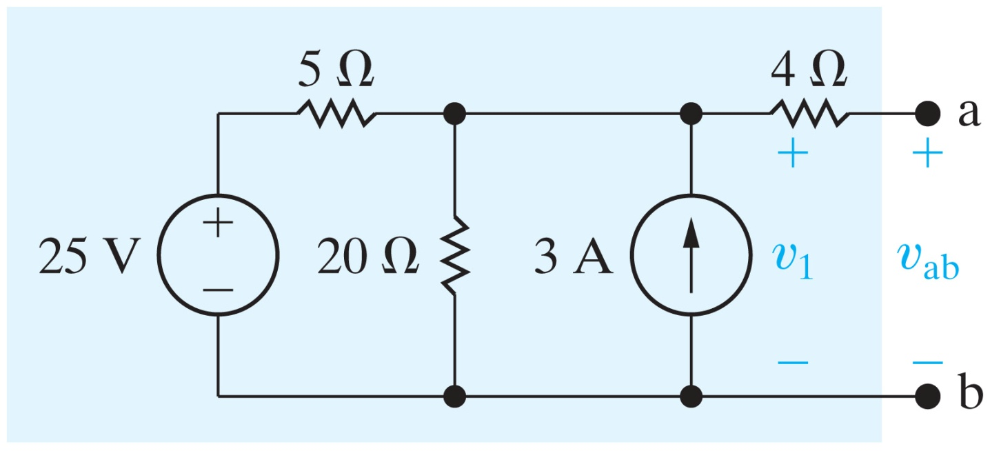
Finding an Equivalent Circuit
Find the Thevenin equivalent circuit for
ECE 201 Circuit Theory I

Slide 9
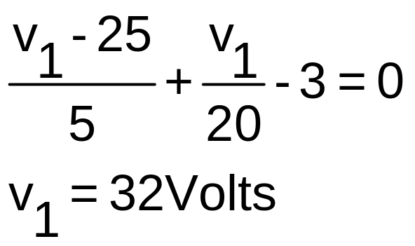
Determine the voltage at a-b
ECE 201 Circuit Theory I

Slide 10
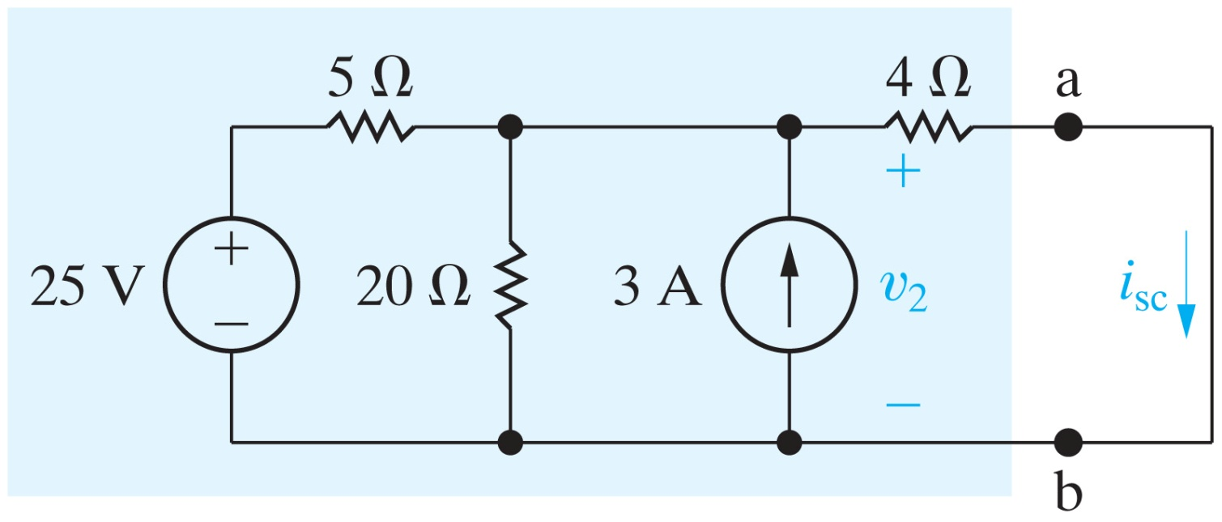
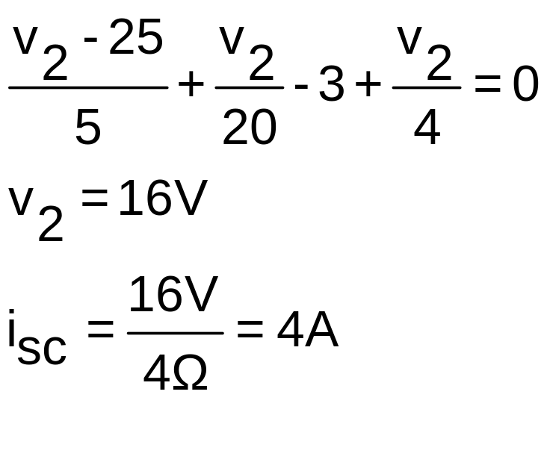
Determine the short-circuit current
ECE 201 Circuit Theory I

Slide 11
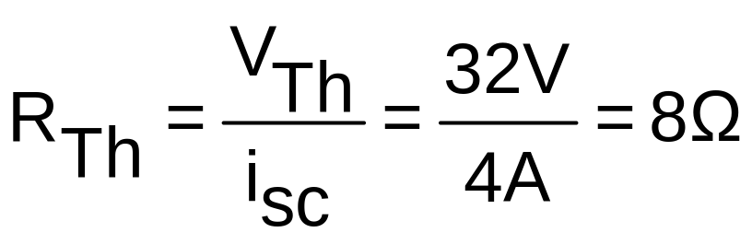
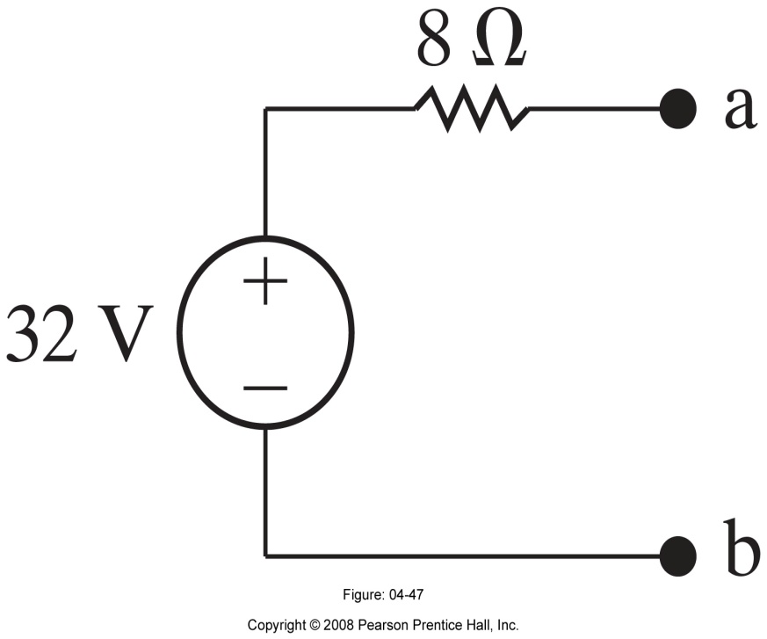
The Thevenin Equivalent Circuit
By Ohm’s Law,
ECE 201 Circuit Theory I

Slide 12


Summary
ECE 201 Circuit Theory I

Slide 13
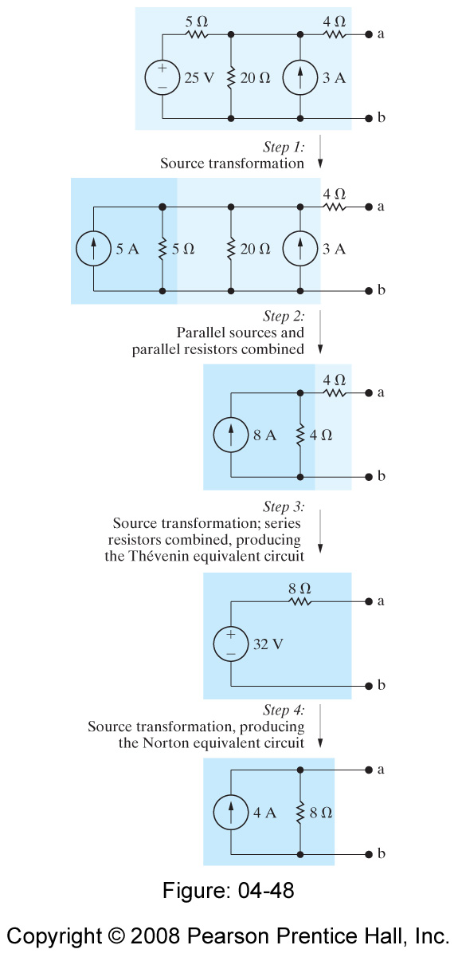
The Norton Equivalent Circuit
Get the Norton Equivalent Circuit from the Thevenin by Source Transformation.
ECE 201 Circuit Theory I

Slide 14
Alternate Way to Determine the Thevenin Resistance
If the sources are all Independent
ECE 201 Circuit Theory I

Slide 15
If the Sources Are All Independent
Look into the a-b terminals with all sources set equal to 0.
  Voltage Sources go to Short Circuits
  Current Sources go to Open Circuits
Determine the resistance
ECE 201 Circuit Theory I

Slide 16
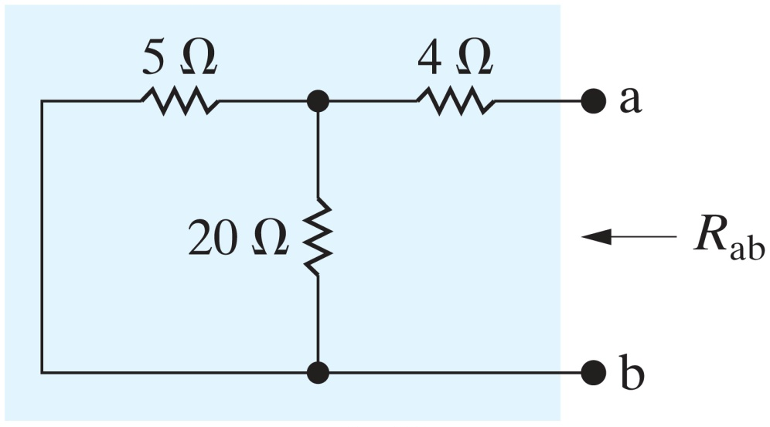
For our Example
ECE 201 Circuit Theory I

Slide 17
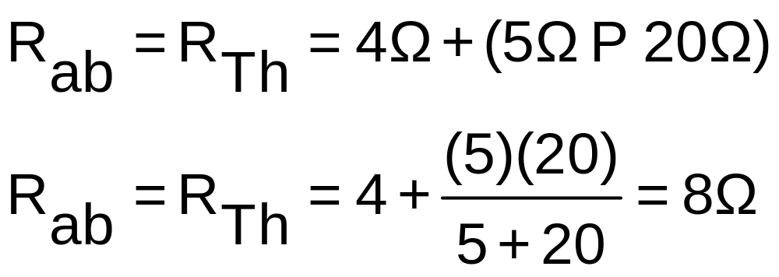
Looking into the a-b terminals
ECE 201 Circuit Theory I

